Slide 1
ARTIFICIAL INTELLIGENCE
SEMESTER : 8
SUBJECT CODE : 2180703

Slide 2
UNIT 7
Statistical Reasoning

Slide 3
Introduction
We have described several representation techniques that can be used to model belief systems in which, at any given point in time, a particular fact is believed to be true, believed to be false or not considered to be either.
But for some kinds, it is useful to be able to describe beliefs that are not certain but for which there is some supporting evidence.
For example, problems that contain genuine randomness. E.g. Card Games
Problems that could, in principle be modeled using the techniques that we used in uncertainty.
For such problems, statistical measures may serve a very useful function as summaries of the world; rather than looking for all possible exceptions we can use a numerical summary that tells us how often an exception of some sort can be expected to occur.
This is useful for dealing with problems where there is randomness and unpredictability (such as in games of chance) and also for dealing with problems where we could, if we had sufficient information, work out exactly what is true.
To do all this in a principled way requires techniques for probabilistic reasoning.

Slide 4
Statistical Reasoning
Probability & Bayes Theorem
In probability theory, Bayes' theorem or Bayes' rule describes the probability of an event, based on the prior knowledge of conditions that might be related to the event.
The Bayes’ theorem is expressed in the following formula:
Where,
P(A|B) – the probability of event A occurring, given that event B has occurred
P(B|A) – the probability of event B occurring, given that event A has occurred
P(A) – the probability of event A
P(B) – the probability of event B
𝑃(𝐴|𝐵) = 𝑃(𝐵|𝐴) ∙ 𝑃(𝐴)
𝑃(𝐵)

Slide 5
Suppose in a school with 100 students. Out of those 55 students study math (event A), 25 study biology (event B), and 20 study both.
Here,
P(A|B) = probability that a student studies math given that he studies biology
P(B|A) = probability that a student studies biology given that he studies math
Now suppose, if we want to find what is the probability that a student selected randomly studies math given that he studies biology also?
As per the Condition probability definition:
(A given B) : 𝑃(𝐴|𝐵) = 𝑃(𝐴 ∩ 𝐵) / 𝑃(𝐵)
(B given A) : 𝑃(𝐵|𝐴) = 𝑃(𝐴 ∩ 𝐵) / 𝑃(𝐴)

Slide 6
Applying Bayes' Theorem,
Bayes’ theorem is used in various disciplines like statistics, medicine, management, different fields of finance, etc.
𝑃(𝐴|𝐵) = 𝑃(𝐵|𝐴) ∙ 𝑃(𝐴)
𝑃(𝐵)
𝑃(𝐴|𝐵) = (0.20) ∙ (0.55) = 0.8
(0.55). (0.25)
𝑃(𝐵|𝐴) = (0.8) ∙ (0.25) = 0.36
(0.55)

Slide 7
Certainty Factors & Rule Based Systems
In this we are trying to describe a practical way of compromising on a pure Bayesian System.
We will use MYCIN as an example here which uses LISP and acts as an Expert System.
MYCIN uses the rules to reason Backwards to the clinical data available from its goal of finding significant disease-causing organisms.
Each rule has a certainty attached to it. Once the identities of the organism are found, it then attempts to select a therapy by which the disease can be treated.
A certainty factor (CF [h, e] )is defined in terms of two components:
MB[h, e]- a measure (between 0 and 1) of belief in hypothesis “h” given the evidence “e”.
MB measures the extent to which the evidence supports the hypothesis.
It is zero if the evidence fails to support the hypothesis.
MD[h, e]- a measure (between 0 and 1) of disbelief in hypothesis “h” given the evidence “e”.
MD measures the extent to which the evidence supports the negation of the hypothesis. It is zero if the evidence support the hypothesis.
CF[h, e] = MB[h, e]- MD[h, e]

Slide 8
Since any particular piece of evidence either supports or denies a Hypothesis (but not both) and since each MYCIN rule corresponds to one piece of evidence (can be compound piece of evidence) a single number suffices for each rule to define both MB and MD and thus the CF.
The CFs are provided by the experts who write the rules. They reflect the experts’
assessments of the strength of the evidence in support of the Hypothesis.
At times CFs need to be combined to reflect the operation of multiple pieces of evidence and multiple rules applied to a problem.
The combining functions should satisfy the following properties :
Since the order in which evidence is collected is arbitrary, the combining functions should be commutative and associative.

Slide 9
Until certainty is reached, additional confirming evidence should increase MB and similarly for disconfirming evidence, MD.
If uncertain inference are chained together, then the result should be less certain that either of the inferences alone.
By use of CFs we reduce the complexity of a Bayesian reasoning system by making some approximations to the formalism.

Slide 10
Bayesian Networks
It is an alternative approach to what we did in the previous section.
The idea is to describe the real world, it is not necessary to use a huge joint probability table in which we list the probabilities of all combinations, because most events are independent of each other, there is no need to consider the interactions between them.
We will use a more local representation in which we will describe clusters of events that interact.
Let us consider an example as,
S: sprinkler was on last night W: grass is wet
R: it rained last night

Slide 11
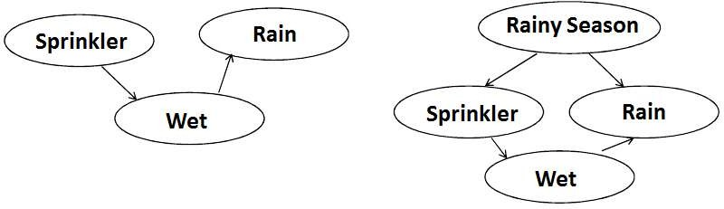
There are two different ways that propositions can influence the likelihood of each other.
The first is that causes influence to the likelihood of their symptoms.
The second is that observing a symptom affects the likelihood of all its possible causes.
The main idea behind the Bayesian network structure is to make a clear distinction between these two kinds of influences.
The Graph in above figure is known as DAG (Directed A cyclic Graph) that represents causality relationships among the variables.
However, we need more information. In particular, we need to know, for each value of a parent node, what evidence is provided about the values that the child node can take on.

Slide 12
We create a probability table for that.
When the most genuine reasoning does not seem true then we need to use an undirected graph in which the arcs can be used to transmit probabilities in either direction, depending upon where the evidence came from.
We have to ensure that there is no cycle that exists between the evidences.
Three algorithms are available for doing these computations
A message-passing method.
A cliché triangulation method.
A variety of stochastic algorithms.
The message-passing approach is based on the observation that to compute the probability of a node A given what is known about other nodes in the network.

Slide 13
It is necessary to know three things.
The total support arriving at A from its parents.
The total support arriving at A from its children.
The entry in the fixed condition probability matrix that relates A to its causes.
Cliché triangulation method.
Explicit arcs are introduced between pair of nodes that share a common descendent.
Stochastic Algorithm or Randomized Algorithms
The idea is to shield a given node probabilistically from most of the other nodes in the network. These algorithms run faster but may not give correct results.

Slide 14
Dempster – Shafer Theory
Till now, we have talked about individual propositions and assign to each of them a single number of the degree of belief that is warranted given the evidence.
In Dempster-Shafer Theory we consider sets of propositions and assign to each of them an interval in which the degree of belief must lie.
[Belief, Plausibility]
Belief (denoted as Bel) measures the strength of the evidence in favor of a set of propositions.
It ranges from 0 ( no evidence) to 1 (definite certainty)
Plausibility (PI) is,
PI(s) = 1- Bel(¬s)
It also ranges from 0 to 1 and measures the extent to which evidence in favor of ¬s leaves room for belief in s.
In short if we have certain evidence in favor of (¬s), then Bel(not(s)) will be 1 and Pl(s) will be 0.
This tells us that the only possible value for Bel(s) is also 0.
The interval, also tells about the amount of information that we have.
If we have no evidence we say that the hypothesis is in the range of [0, 1].

Slide 15
As we gain more evidence, this interval can be expected to shrink, and giving confident answers. This is different from Bayesian as in that we would probably begin by distributing the probability among the hypotheses (.33 in case of 3) and we may end up with the same probability at the end, but in Dempster we state that we have no information at the start and everything is in the range of 0 to 1.
Let’s take an example where we have some mutually exclusive hypothesis.
{Allergy, Flu, Cold, Pneumonia}, The set is denoted by θ.
We want to attach some measure of belief to elements of θ.
But all evidences are not directly supportive of individual elements.
The key function we use here is a Probability Density Function, denoted by m.
The function m, is not only defined for elements of θ but also all subsets of it.
The quantity m(p) measures the amount of belief that is currently assigned to exactly to
the set “p” of hypothesis.

Slide 16
If θ contains n elements then there are 2n subsets of θ.
We must assign m so that the sum of all the m values assigned to subsets of θ is 1.
At the beginning we have m as under θ = (1.0)
If we get an evidence of .6 magnitude that the correct diagnosis is in the set {Flu, Cold, Pneu} then,
{Flu, Cold, Pneu} = (0.6)
θ = (0.4)
This does not lead us anywhere, we need more information.
Now to move further, let’s consider we have two belief function m1 and m2.
Let X be the set of subsets of θ to which m1 assigns a nonzero value and let Y be the corresponding set for m2.
We define m3, as a combination of the m1 and m2 to be,

Slide 17
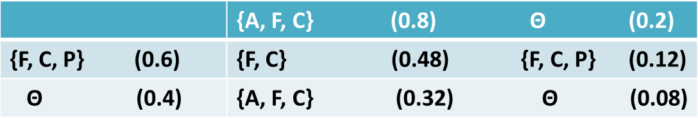
𝐦𝟑 (𝐙) = ∑𝐗∩𝐘=𝐙 𝐦𝟏(𝐗) ∙ 𝐦𝟐(𝐘)
𝟏 − ∑𝐗∩𝐘=∅ 𝐦𝟏(𝐗) ∙ 𝐦𝟐(𝐘)
For example, suppose m1 corresponds to our belief after observing fever:
m1= { F, C, P} = 0.6
θ = (0.4)
suppose m2 corresponds to our belief after observing runny nose:
m2= { A ,F, C} =0.8
θ = 0.2
Then we can compute their combination m3 using the following table.

Slide 18
Fuzzy Logic
Fuzzy logic is a form of many-valued logic in which the truth values of variables may be any real number between 0 and 1.
By contrast, in Boolean logic, the truth values of variables may only be the integer values 0 or 1.
Fuzzy logic has been employed to handle the concept of partial truth, where the truth value may range between completely true and completely false.
Furthermore, when linguistic variables are used, these degrees may be managed by specific (membership) functions.
In the standard Boolean definition for tall people are either tall or not and there must be a specific height that defines the boundary.
Once set membership has been redefined in this way, it is possible to define a reasoning system based on the techniques for combining distributions.
Such methods have been used in control systems for devices like trains, AC, and washing machines.

Slide 19
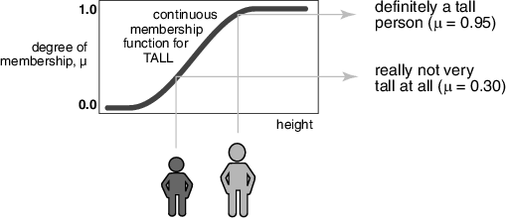
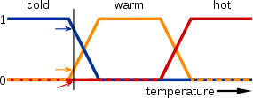
The concepts of Fuzzy Logic are extensively applied in business, finance, aerospace, defense, etc.

Slide 20
In above image, the meanings of the expressions cold, warm, and hot are represented by functions mapping a temperature scale.
A point on that scale has three "truth values"—one for each of the three functions.
The vertical line in the image represents a particular temperature that the three arrows (truth values) gauge.
Since the red arrow points to zero, this temperature may be interpreted as "not hot". The orange arrow (pointing at 0.2) may describe it as "slightly warm" and the blue arrow (pointing at 0.8) "fairly cold".

Slide 21
Fuzzy Sets and Membership function
Fuzzy logic is a set of mathematical principles for knowledge representation based on degrees of membership rather than on crisp membership of classical binary logic.
Unlike two-valued Boolean logic, fuzzy logic is multi-valued. It deals with degrees of membership.
The concept of a set is fundamental to mathematics. Crisp set theory is governed by a logic that uses one of only two values: true or false.
This logic cannot represent vague concepts, and therefore fails to give the answers on the inconsistencies.
In fuzzy set theory, an element is with a certain degree of membership. Thus, a proposition is not either true or false, but may be partly true (or partly false) to any degree.
This degree is usually taken as a real number in the interval [0,1].

Slide 22
The classical example in fuzzy sets is tall men. The elements of the fuzzy set “tall men” are all men, but their degrees of membership depend on their height.
In the classical logic, we have a crisp set in which if we ask the question: Is the man tall? Then the tall men are above 180, and not tall men are below 180.
Fuzzy set asks the question: How tall is the man? The tall is partial membership in the fuzzy set, e.g. Mike is 0.9 tall.
Name | Height in cm | Degree of Membership
 |  | Crisp | Fuzzy
John | 208 | 1 | 1
Tom | 181 | 1 | 0.8
Bob | 152 | 0 | 0.0
Mike | 198 | 1 | 0.9
Billy | 158 | 0 | 0.4

